Slide 1

Fast Food Nutrition
EDA and answers to Section 3 (Q1-Q10) · 8 chains · 513 menu items
Suman Bajani
BWU/MCA/25/039
SEC:A
Notes:
1

Slide 2
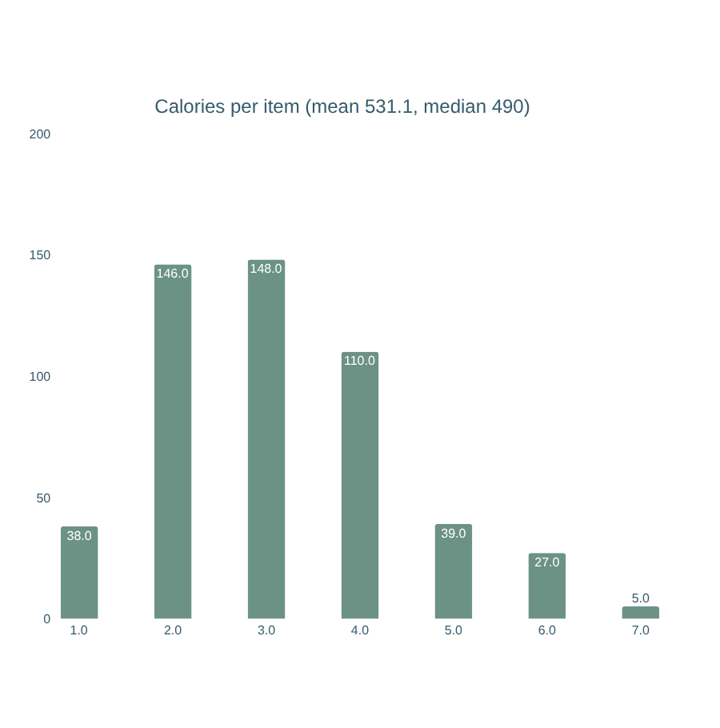
EDA
Dataset overview and cleaning
513
17
items after removing 2 exact duplicates
columns: 14 numeric nutrients + restaurant, item, salad flag
41.3%
All 'Other'
missing Vitamin A (Vit C / calcium ~40%); fiber 2.3%, protein 0.2%
salad column has no 'Salad' value, so salads found by item name (63)
Notes:
2

Slide 3
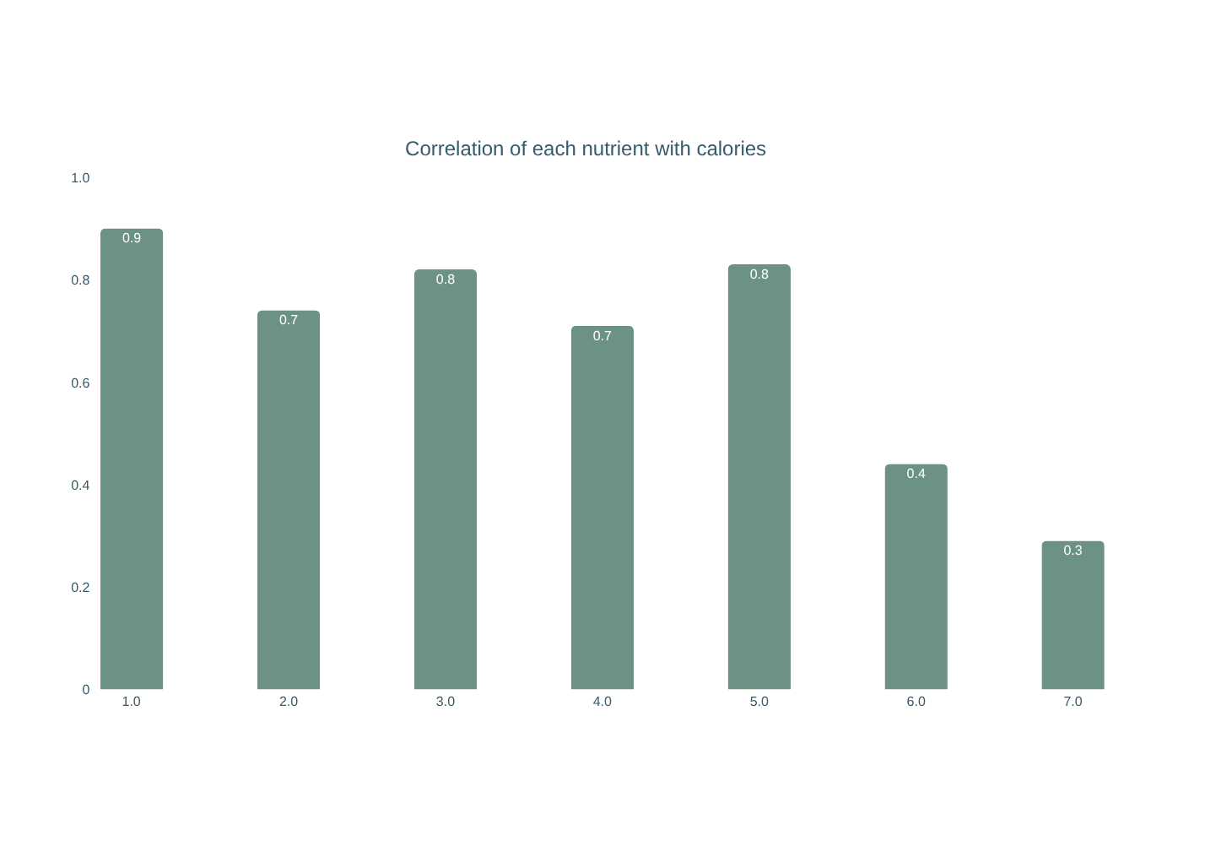
EDA
Relationships and outliers
ANSWER
Bigger items have more of everything
Calories track total fat (0.90), protein (0.83) and sodium (0.82) most closely; sugar (0.44) and fiber (0.29) are weaker.
Calories are right-skewed (skew 1.4): a few very heavy items such as 2,000+ kcal tender buckets are real menu items, so they were kept.
Notes:
3

Slide 4
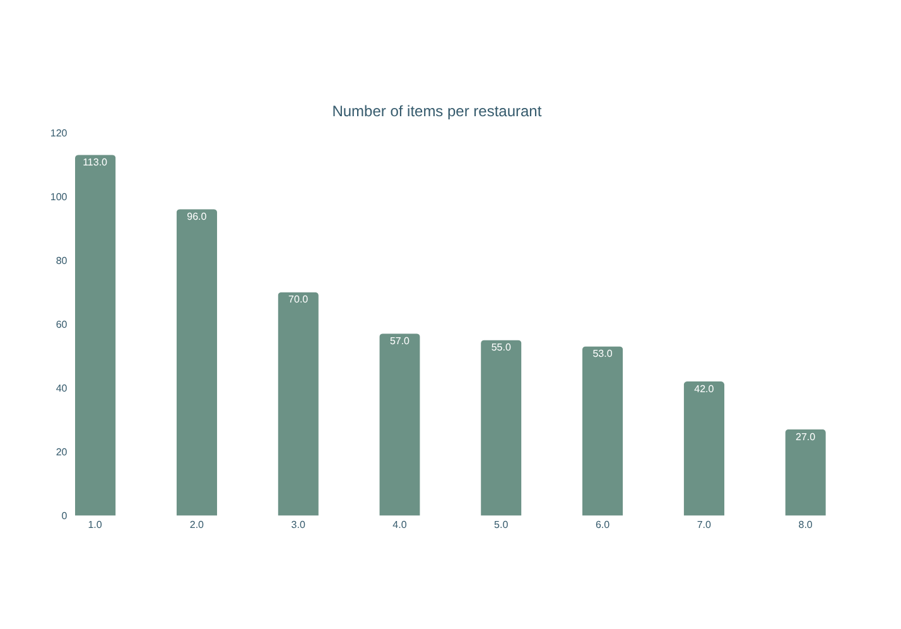
Q1
Which restaurant has the most food items?
ANSWER
Taco Bell
113 of 513 items (22%). Subway is next with 96; Chick-fil-A has the smallest menu with 27.
Notes:
4

Slide 5
Q2
Top 10 items by calories
# | Item | Restaurant | kcal
1 | 20 piece Buttermilk Crispy Chicken | McDonald's | 2,430
2 | 40 piece Chicken McNuggets | McDonald's | 1,770
3 | 10 piece Sweet N' Spicy Honey BBQ | McDonald's | 1,600
4 | American Brewhouse King | Burger King | 1,550
5 | 12 piece Buttermilk Crispy Chicken | McDonald's | 1,510
6 | Garlic Parmesan Dunked Ultimate Ch | Sonic | 1,350
7 | Super Sonic Bacon Double Cheesebur | Sonic | 1,280
8 | 6 Piece Chicken Strip Basket w/ Co | Dairy Queen | 1,260
9 | Rodeo King | Burger King | 1,250
10 | Super Sonic Double Cheeseburger W/ | Sonic | 1,220
ANSWER
2,430 kcal
20 piece Buttermilk Crispy Chicken... (McDonald's) is the highest. The top 10 come from McDonald's, Sonic, Burger King and Dairy Queen, mostly large shareable chicken and double-burger items.
Notes:
5

Slide 6
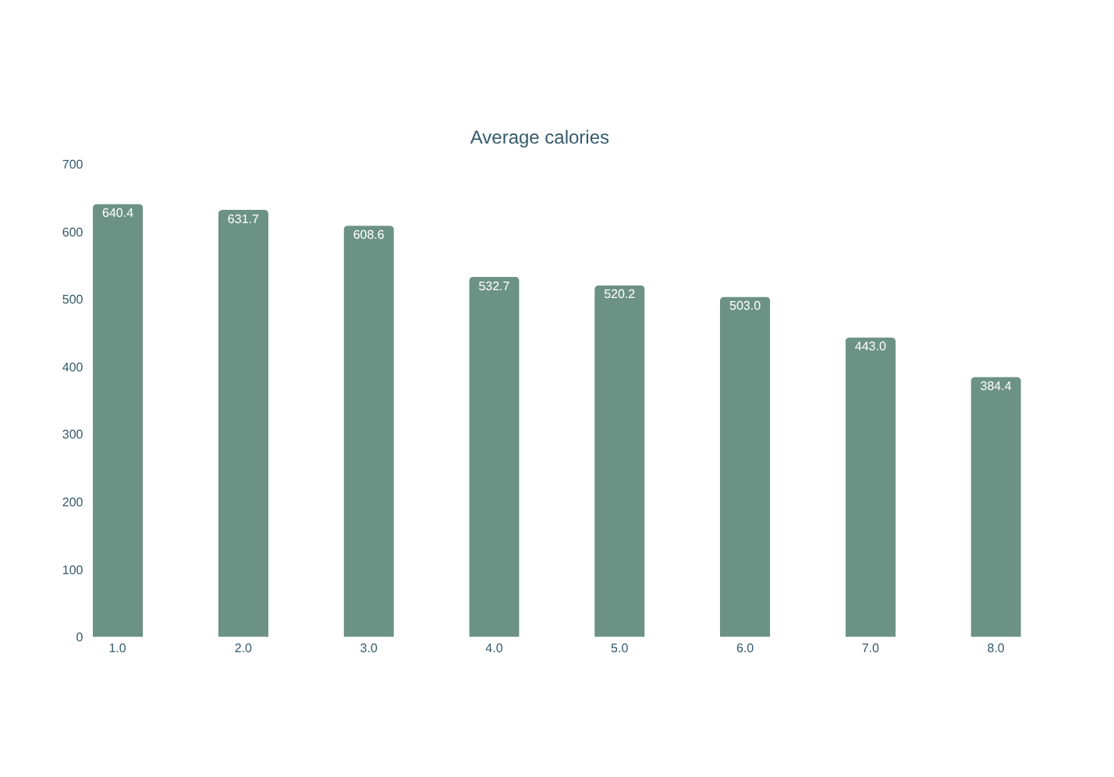
Q3
Average calories per item by restaurant
ANSWER
640 vs 384 kcal
McDonald's has the highest average and Chick-fil-A the lowest. The overall mean is 531.1 kcal.
Notes:
6

Slide 7
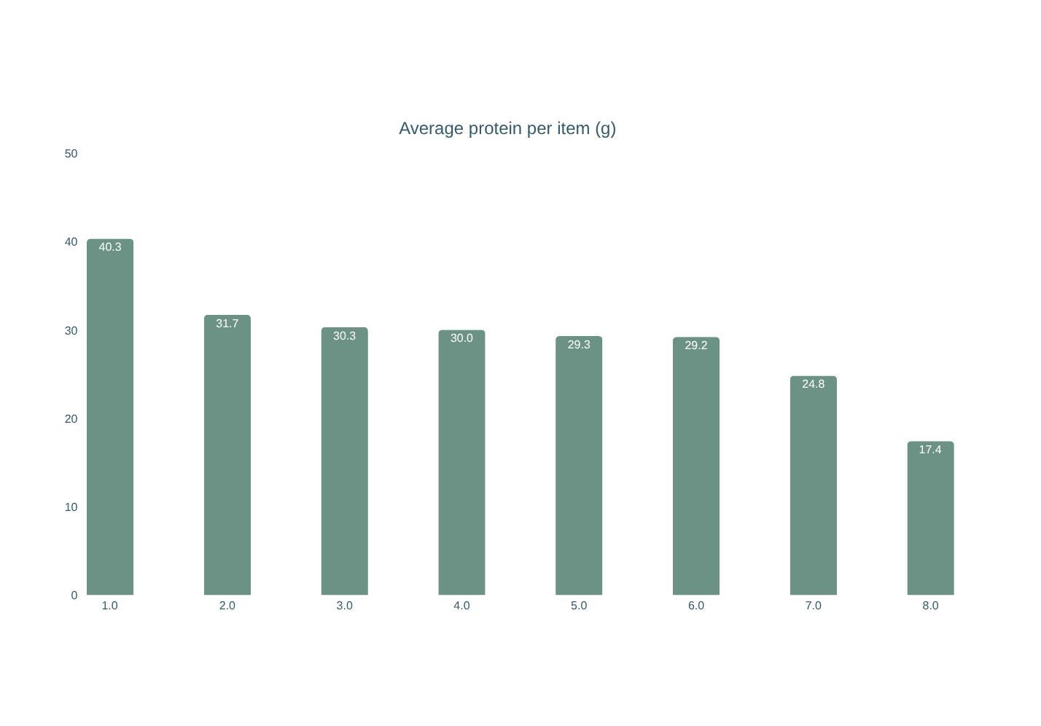
Q4
Which restaurant has the highest average protein?
ANSWER
McDonald's 40.3 g
Well ahead of Chick-fil-A (31.7 g). Taco Bell is lowest at 17.4 g.
Notes:
7

Slide 8
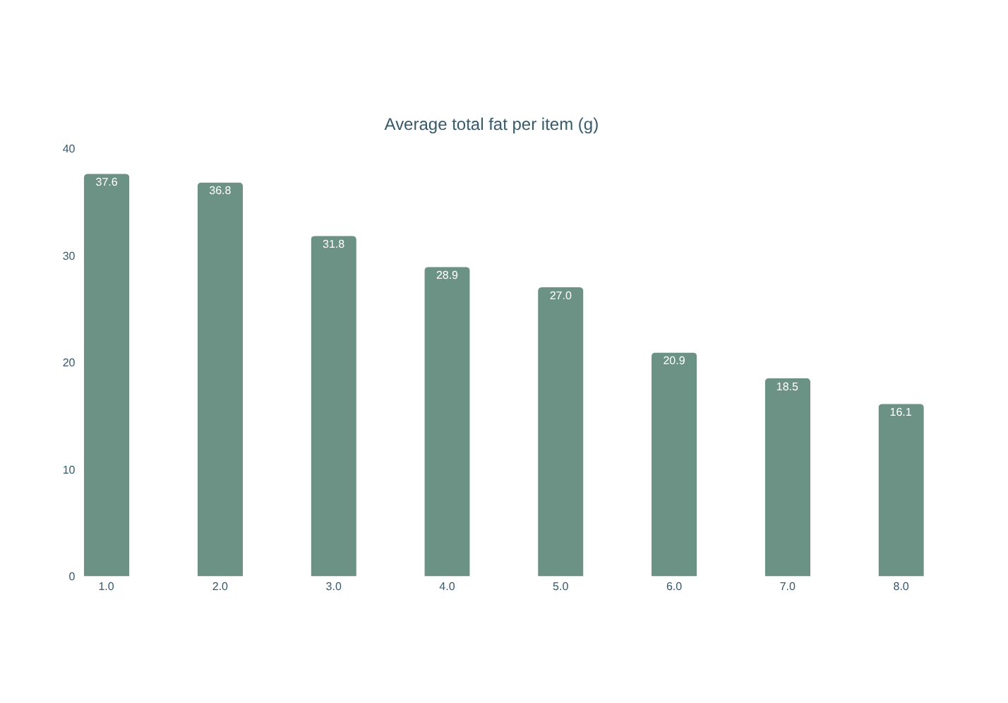
Q5
Highest and lowest average total fat
ANSWER
High: Sonic
Low: Chick-fil-A
Sonic averages 37.6 g of fat per item; Chick-fil-A averages just 16.1 g, less than half.
Notes:
8

Slide 9
Q6
Highest-sugar items and their calories
# | Item | Restaurant | Sugar g | kcal
1 | 10 piece Sweet N' Spicy Honey BBQ | McDonald's | 87 | 1,600
2 | 6 piece Sweet N' Spicy Honey BBQ G | McDonald's | 52 | 960
3 | Chicken, Apple & Cranberry Salad w | Burger King | 37 | 700
4 | Footlong Sweet Onion Chicken Teriy | Subway | 36 | 760
5 | 4 piece Sweet N' Spicy Honey BBQ G | McDonald's | 35 | 640
6 | Chicken, Apple & Cranberry Salad w | Burger King | 34 | 560
7 | Large Cheese Curds | Dairy Queen | 30 | 1,050
8 | Footlong Corned Beef Reuben | Subway | 24 | 940
9 | Footlong Meatball Marinara | Subway | 24 | 960
10 | Arby-Q Sandwich | Arby's | 23 | 400
ANSWER
87 g sugar
10 piece Sweet N' Spicy Honey BBQ ... (McDonald's) has 1,600 kcal. The top-10 sugar items average about 857 kcal against a menu mean of 531.1: high sugar goes with heavy items (r = 0.44).
Notes:
9

Slide 10
Q7
Salad vs other items: calories, fat, carbs, protein
Average per item | Salad | Other | Change
Calories (kcal) | 364.4 | 554.4 | -34%
Total fat (g) | 20.4 | 27.5 | -26%
Carbs (g) | 23.4 | 48.8 | -52%
Protein (g) | 22.9 | 28.6 | -20%
ANSWER
Salads are lighter
Salads: 63 items · Other: 450 items
About 34% fewer calories, 26% less fat and 52% fewer carbs. Protein drops only 20%, so salads keep most of their protein.
Notes:
10

Slide 11
Q8
Best mix of low calories and high protein
Restaurant | Avg kcal | Avg protein g | Protein per 100 kcal | Score
Chick-fil-A | 384.4 | 31.7 | 8.2 | 87
Subway | 503 | 30.3 | 6 | 53
McDonald's | 640.4 | 40.3 | 6.3 | 52
Arby's | 532.7 | 29.3 | 5.5 | 43
Dairy Queen | 520.2 | 24.8 | 4.8 | 33
Burger King | 599.7 | 30 | 5 | 32
Taco Bell | 443 | 17.4 | 3.9 | 26
Sonic | 631.7 | 29.2 | 4.6 | 24
ANSWER
Chick-fil-A
Score 87/100: 8.2 g protein per 100 kcal (best), with the lowest average calories (384.4) and 31.7 g protein per item. Score blends protein, protein density and low calories.
Notes:
11

Slide 12
Q9
10 least healthy items (Health Risk Score)
# | Item | Restaurant | Risk score
1 | American Brewhouse King | Burger King | 197
2 | 20 piece Buttermilk Crispy Chicken | McDonald's | 159
3 | Super Sonic Bacon Double Cheesebur | Sonic | 125
4 | Super Sonic Double Cheeseburger W/ | Sonic | 119
5 | Rodeo King | Burger King | 117
6 | Super Sonic Jalapeno Double Cheese | Sonic | 115
7 | Super Sonic Double Cheeseburger W/ | Sonic | 115
8 | Super Sonic Double Cheeseburger W/ | Sonic | 114
9 | Farmhouse King | Burger King | 111
10 | Large Cheese Curds | Dairy Queen | 108
ANSWER
American Brewhouse King
Burger King, score 197. Score = weighted % of daily limits for calories, fat, saturated fat, trans fat, cholesterol and sodium (100 = a full day's limits). Dominated by Sonic, Burger King and McDonald's.
Notes:
12

Slide 13
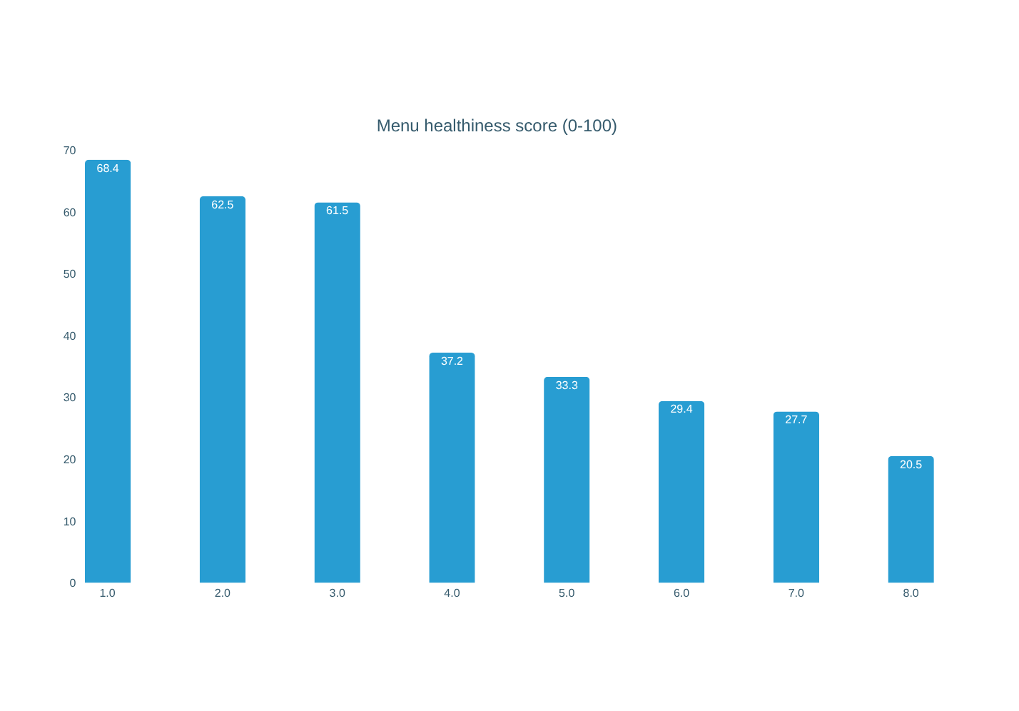
Q10
Healthiest overall menu
ANSWER
Subway wins
Score 68/100, ahead of Taco Bell (63) and Chick-fil-A (62). Built from calories, fat, sodium, sugar (lower is better) and fiber, protein, vitamins (higher is better). Taco Bell leads if sodium and fat are weighted most, so the top 3 are close.
Notes:
13

